Slide 1
Analysis of Image Classification
Will Schnirring, Nathan O’Connor, Ashhad Syed

Slide 2

Recap
Objective
Unsupervised clustering of a >1TB image set
Data source - Google’s Open Images v7
Scikit learn
Python
Popular, well-documented
MiniBatch k-means
K-means clustering on subsets
Data size > system memory
Image processing - Histogram of Gradients(HOG)
Greyscale -> Resize -> Transform -> Feature vector -> dataframe

Slide 3
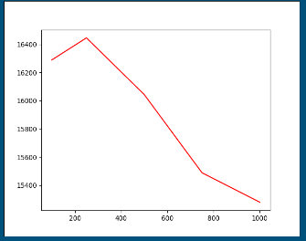
Recap
Train/Test split
Train: 20% 154k images, Test: 80% 606k image
Batch size: 1k images, Cluster count: 1k
Training
Walk through the bucket directory with feature vector dataframes
Call MiniBatchKmeans partial_fit() method on each dataframe to train the model
Testing
Load the model
Read feature vectors not used in training
Call MiniBatchKmeans.predict on feature vectors

Slide 4
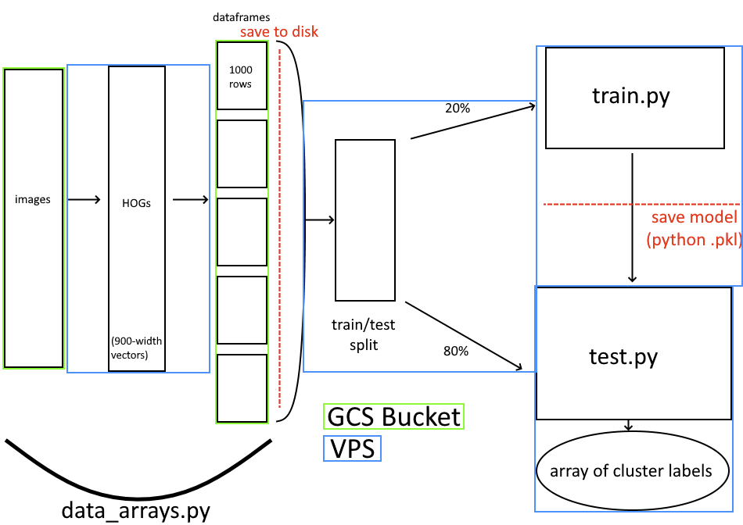
Delta Lake Architecture
Google Cloud VPS + GCS storage bucket
GCSFuse to mount
No download to Read
- - implicit-dirs

Slide 5
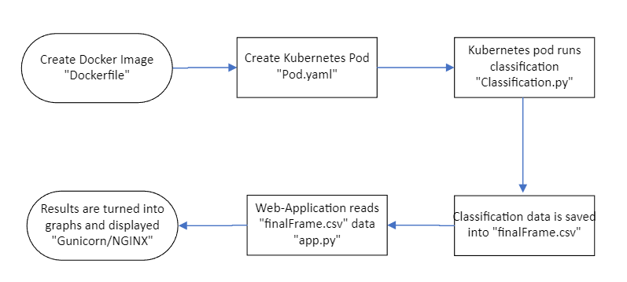
Overview

Slide 6
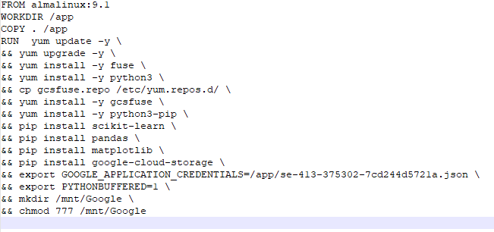
Docker
Create image using a Dockerfile
Image used for kubernetes pod
Runs classification python script
Utilizes google storage bucket

Slide 7
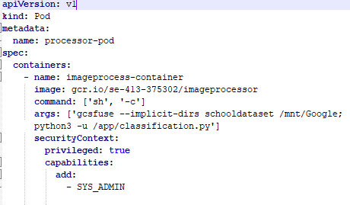
Kubernetes
Creates pod from docker image
Starts a bash shell to accept commands
Mount the google cloud storage bucket
Run the classification.py script
Must be run with elevated permissions

Slide 8
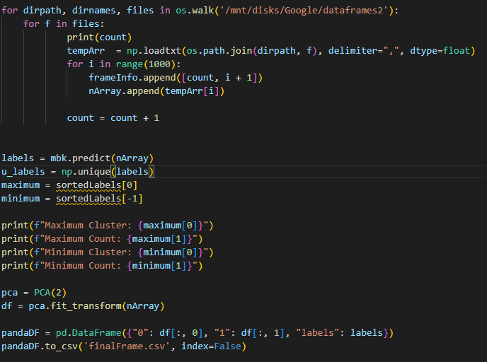
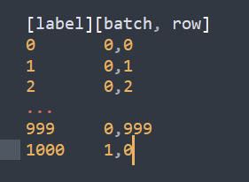
Classification Code
PCA() generates X,Y
900 features -> 2
Upper bound on memory needed
Sort and count labels
Label i =
i % 1000-th image
i / 1000-th batch

Slide 9
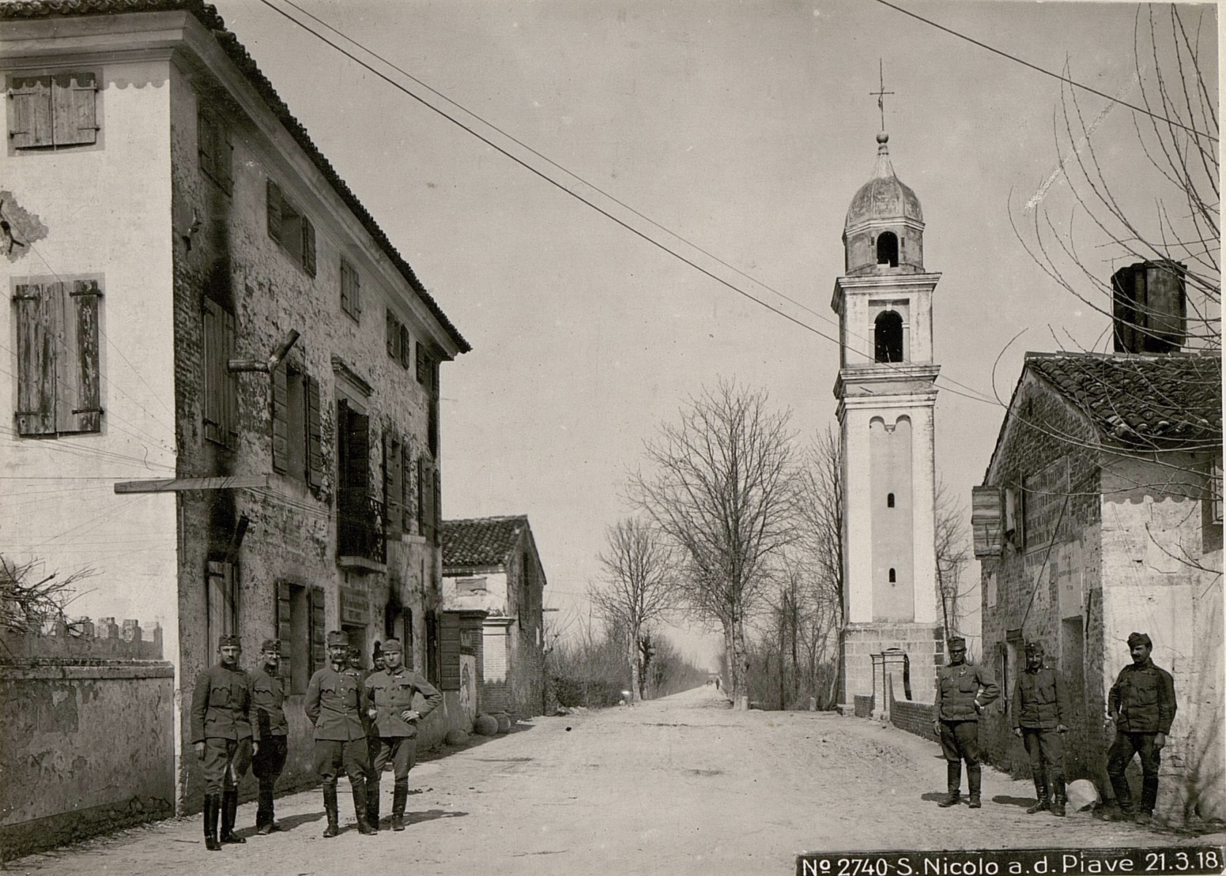
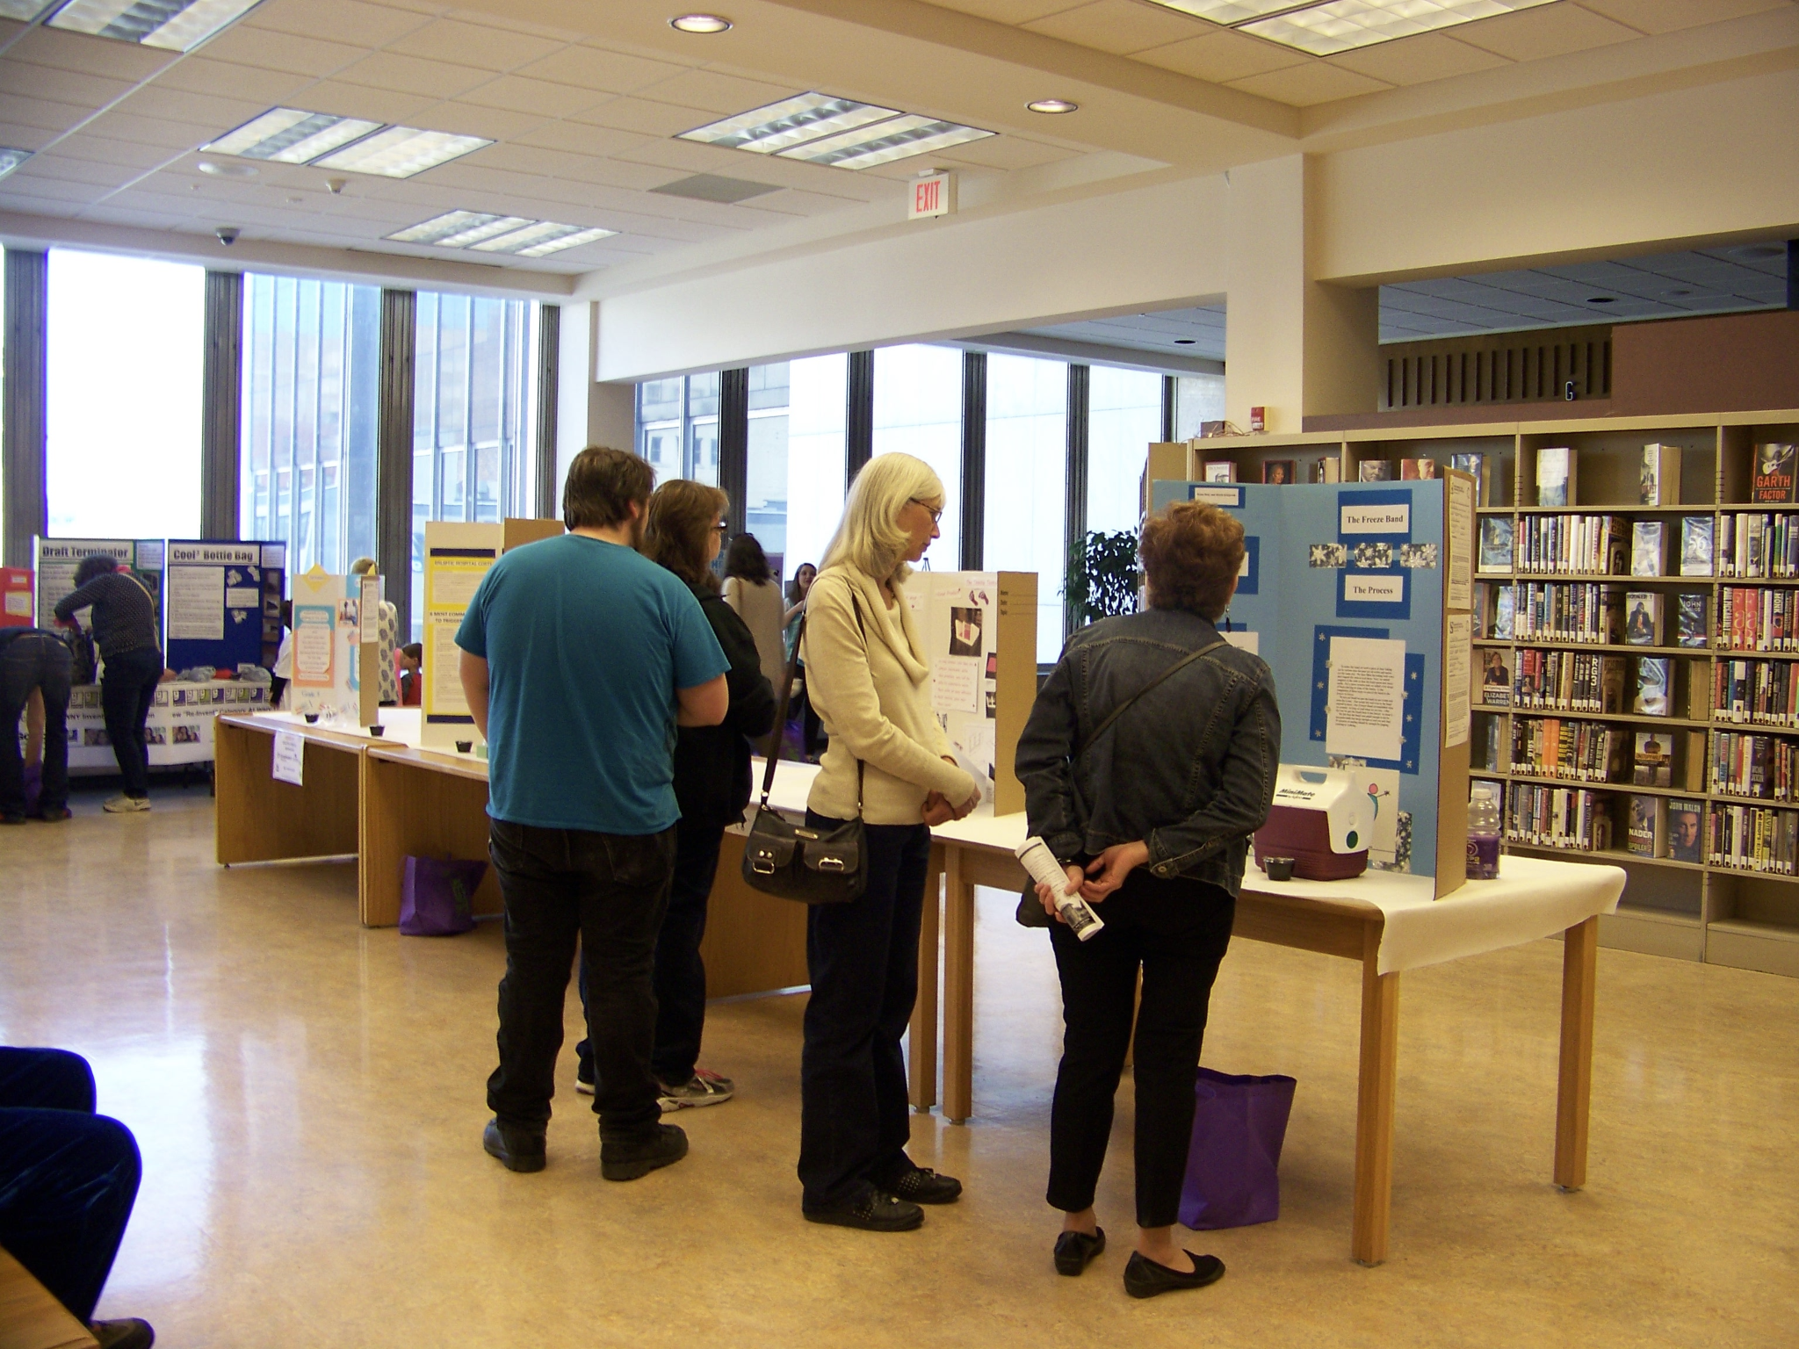
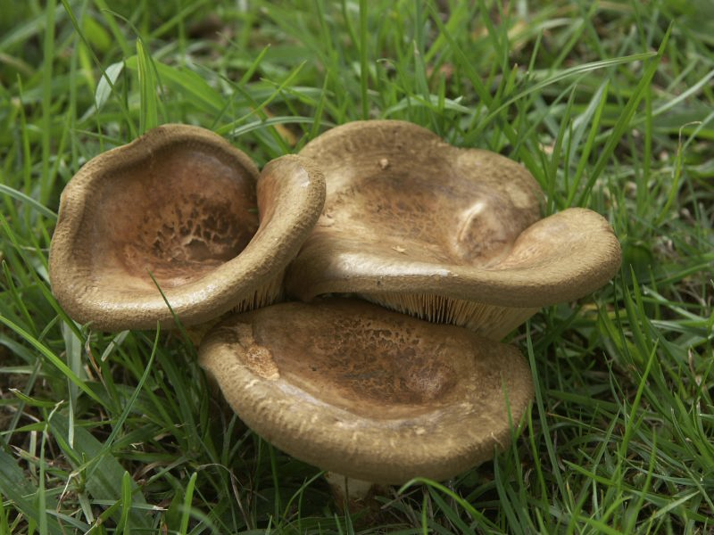
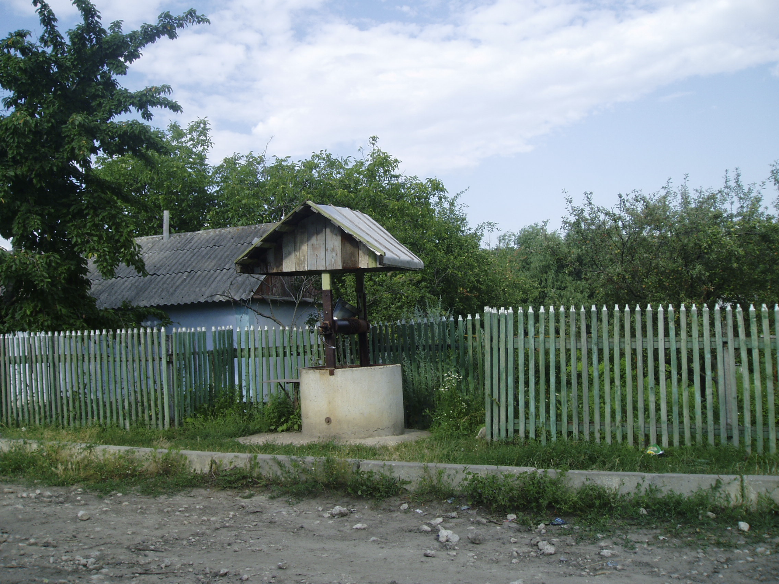
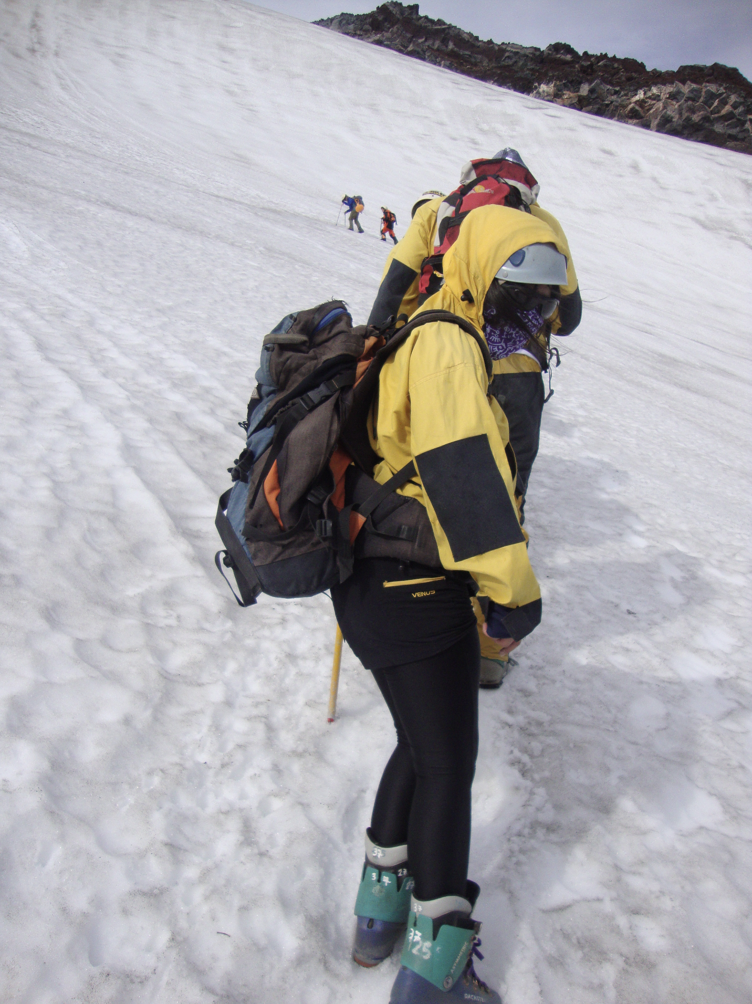
Classification Results
Largest: 3902 images
Smallest: 4 images
Many empty
Low correlation, room for improvement

Slide 10
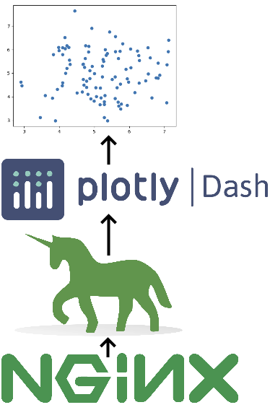
Displaying Results
Python webapp on the VPS
Interactive graphing
Dash (Flask)
Gunicorn + Nginx
Gateway, proxy server

Slide 11
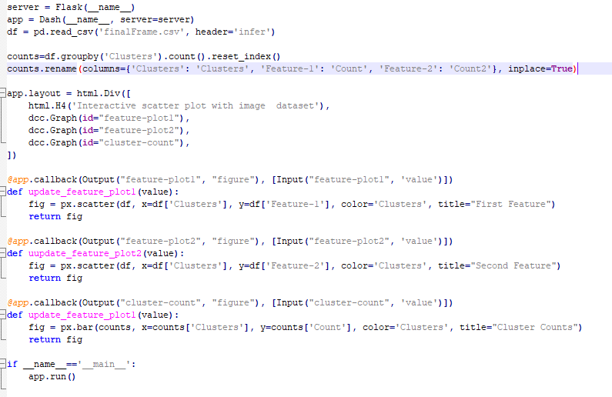
Application Code
Utilize Dash to make interactive images
Uses Flask as a web application framework
3 Charts
1st Feature
2nd Feature
Cluster count

Slide 12
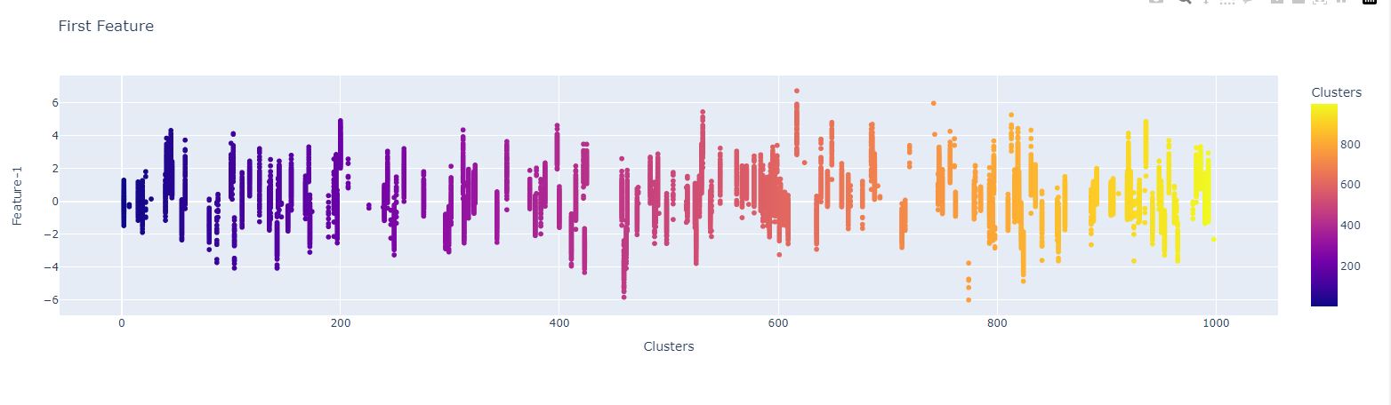
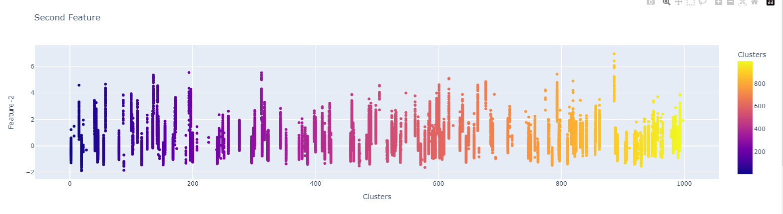
Feature Results

Slide 13
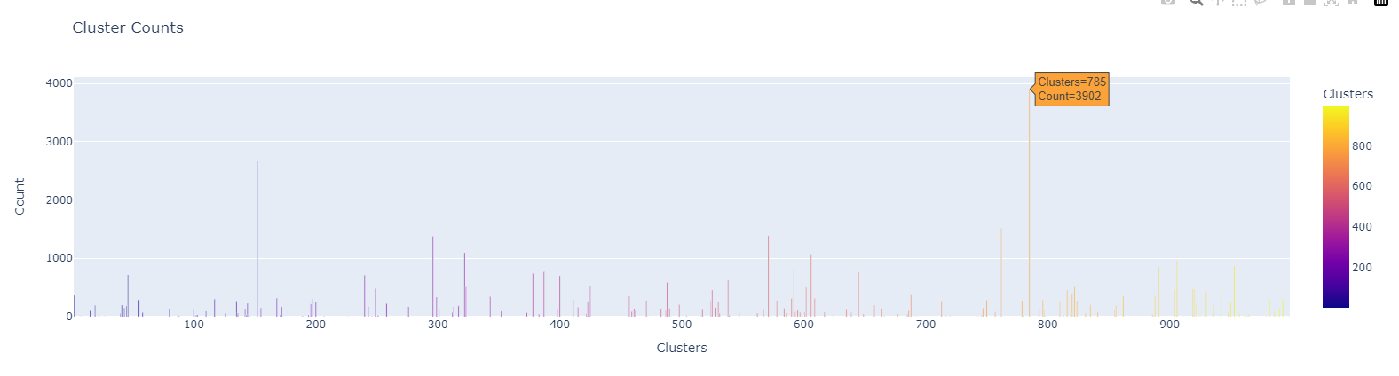
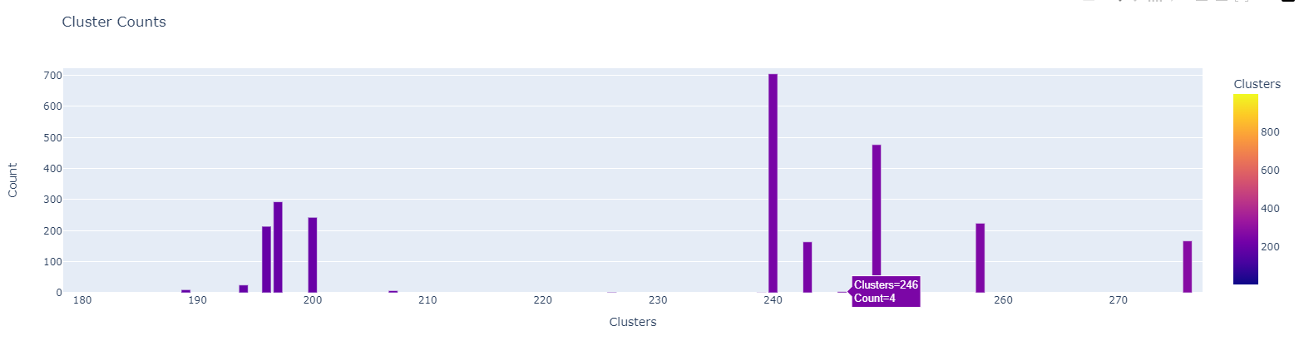
Cluster Count Results

